Slide 1


RSNA Screening Mammography Breast Cancer Detection
Presenters:
Chenglin Zhang
Lihui Chen
Yijia Xue

Slide 2

01
Problem Introduction

Slide 3
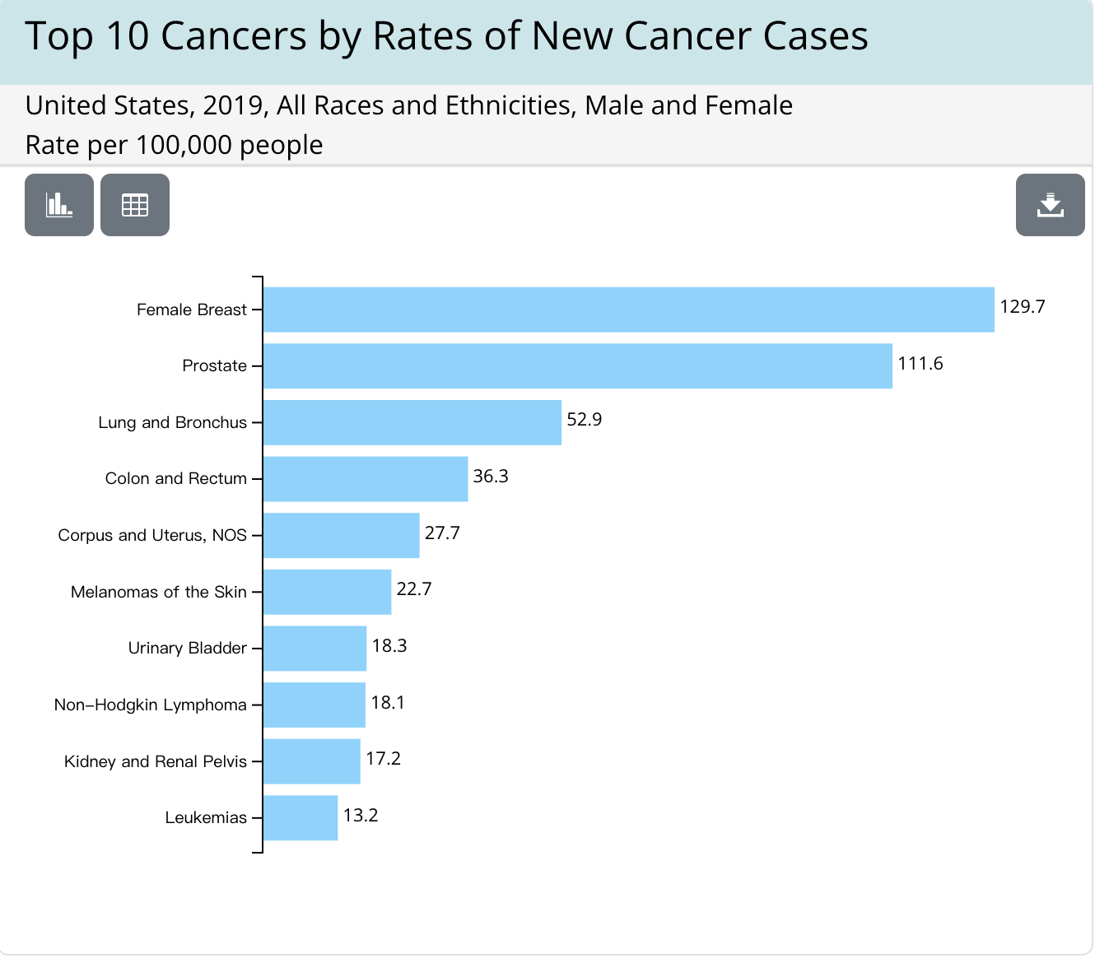
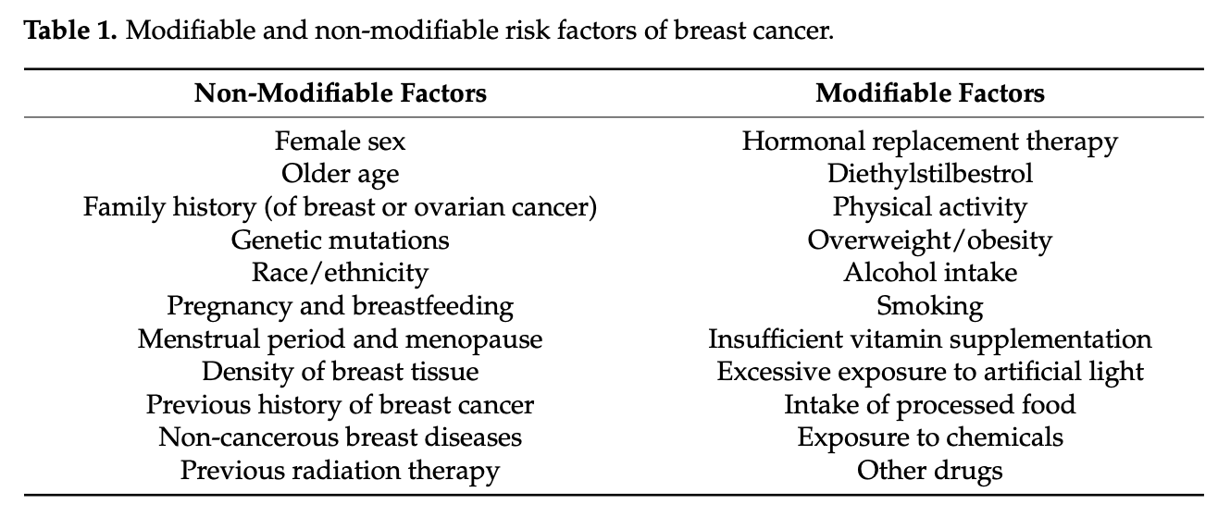

Background
Breast cancer is the most frequently diagnosed cancer in women worldwide with 2.26 million [95% UI, 2.24–2.79 million] new cases in 2020. And in the U.S., breast cancer alone is expected to account for 29% of all new cancers in women (Łukasiewicz et al., 2021)
Figure 1. Top 10 Cancer by Rates of New Cancer Cases
Retrieved from (Łukasiewicz et al., 2021)
Retrieved from https://health.economictimes.indiatimes.com/news/industry/breast-cancer-lack-of-early-detection-killing-thousands-of-women-every-year/94941188

Slide 4
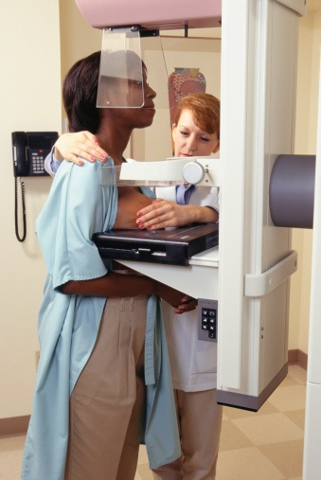
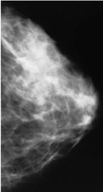
Background
Breast cancer usually lacks evidence in its early stage, which results in late detection of the disease. Detection at advanced stages of the decease implies the treatment is more difficult and uncertain (Milosevic, 2018).
Therefore, an early stage detection is proposed in order to prevent the disease from being diagnosed too late. Mammographic screening is a good way of early detection when resource permitted (Anderson, 2003).
With the advancement of machine learning/deep learning algorithms, and the popularity of mammography in many countries, we aim to incorporate deep learning techniques to “read” the mammography and returns the diagosis of the given mammography.

Slide 5
02
Previous Work and Limitations

Slide 6
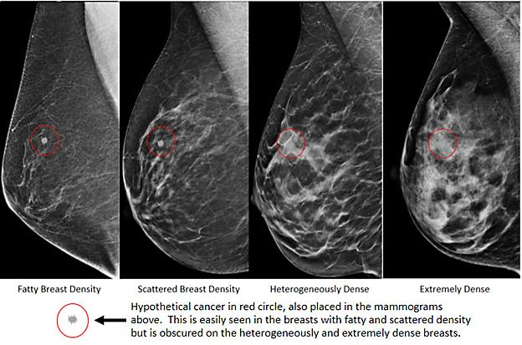
Closer Look at Mammography
Composition of breasts
Fibrous and glandular tissue
higher density
white part on the screening image
Fat
lower density
black part on the screening image
Cancer cells
Unusual white dots on the screening image (circled in red)
This is because of the unusual growth of cells
https://www.snmmi.org/Patients/Procedures/Content.aspx?ItemNumber=13977

Slide 7
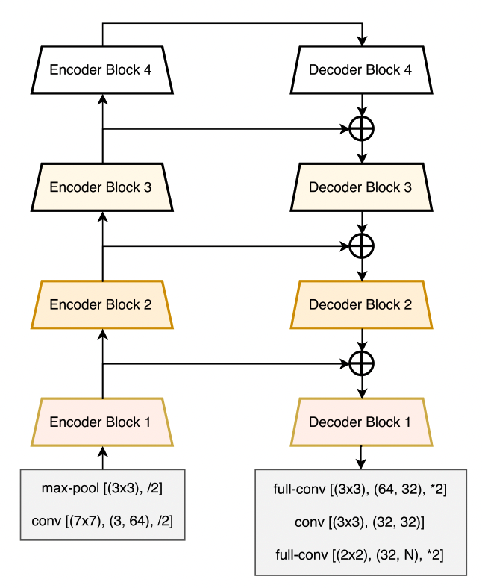
Previous Work
Chaurasia, A., & Culurciello, E. (2017, December). Linknet: Exploiting encoder representations for efficient semantic segmentation. In 2017 IEEE Visual Communications and Image Processing (VCIP) (pp. 1-4). IEEE.
Link each encoder with decoder
Input of each encoder layer is bypassed to the output of its corresponding decoder
Retrieved from: https://ieeexplore-ieee-org.proxy.lib.duke.edu/abstract/document/8305148

Slide 8
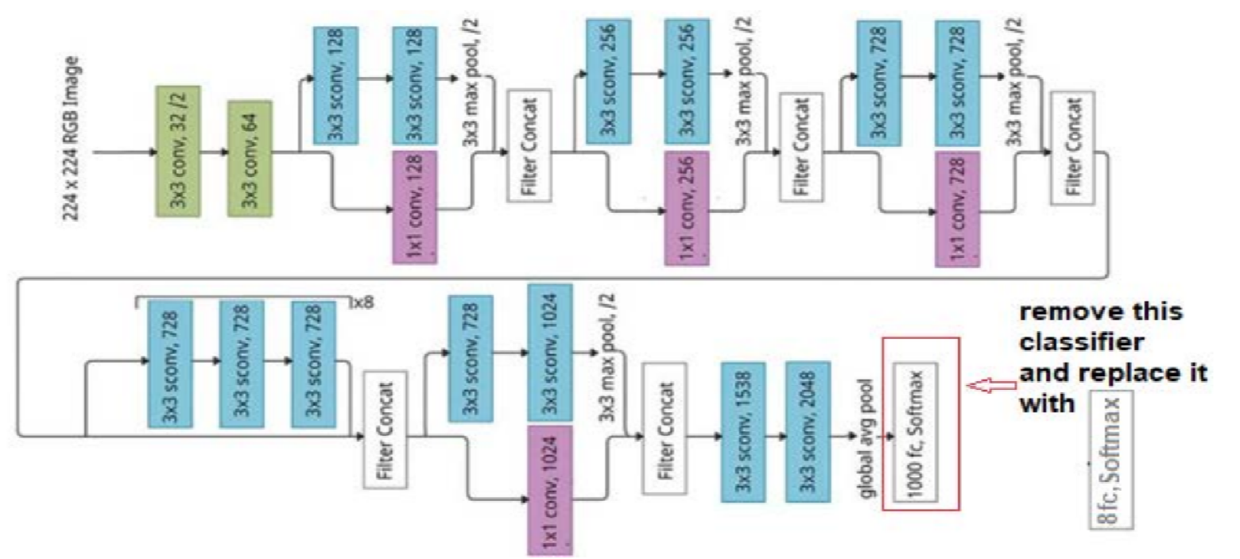
Previous Work
Basem S. Abunasser, Mohammed Rasheed J. AL-Hiealy, Ihab S. Zaqout and Samy S. Abu-Naser, “Breast Cancer Detection and Classification using Deep Learning Xception Algorithm” International Journal of Advanced Computer Science and Applications(IJACSA), 13(7), 2022. http://dx.doi.org/10.14569/IJACSA.2022.0130729
Filter concat
Identity map
Retrieved from: http://dx.doi.org/10.14569/IJACSA.2022.0130729

Slide 9
03
Project
Research
Contents

Slide 10
Work Flow
The screening images (10000+ patients).
Patients’ age.
Density of the breast
Imaging machine type (Brand)
Whether cancer
whether case difficult to identify
F1 probabilistic score
Comparisons among models
Conclusion
Dataset from Kaggle competition:
Model Evaluation and Comparions
Ratio of the cancer: ~1%
Mean age: 58.5
Age range: [26.0, 89.0]
Preprocessing: Resize, center cropping
UNet
Vision Transformer (ViT)
Efficient Net
Exploratory Data Analysis and Data preprocessing
Deep Learning Networks

Slide 11
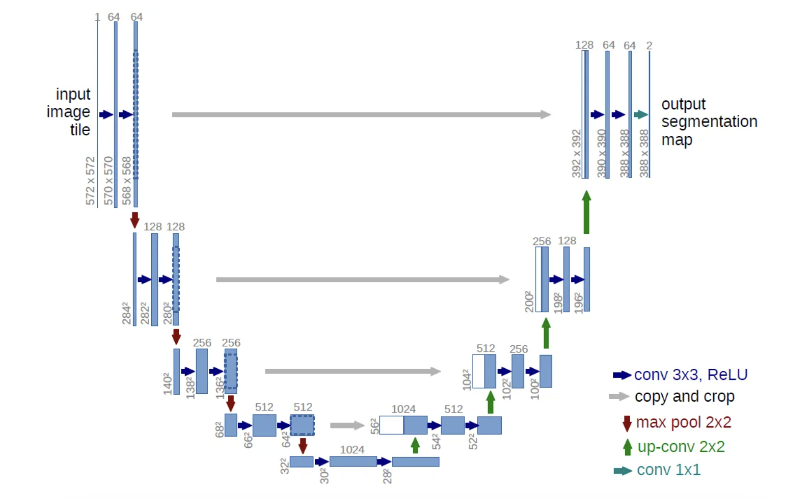
Architecture of U-Net
U-net architecture (example for 32x32 pixels in the lowest resolution). Each blue box corresponds to a multi-channel feature map. The number of channels is denoted on top of the box. The x-y-size is provided at the lower left edge of the box. White boxes represent copied feature maps. The arrows denote the diﬀerent operations.
Downsampling (Encoding)
Upsampling (Decoding)
Skip-Connection
U-Net: Convolutional Networks for Biomedical Image Segmentation https://arxiv.org/abs/1505.04597

Slide 12
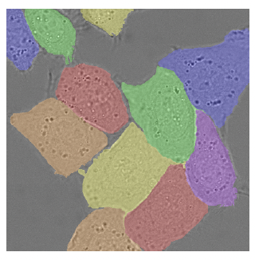
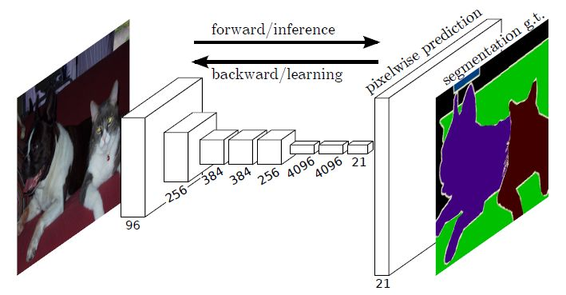
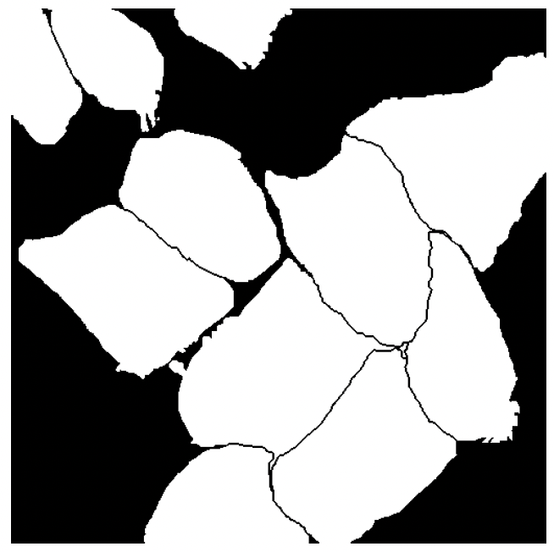
Architecture of U-Net
Segmentaion
U-Net: Convolutional Networks for Biomedical Image Segmentation https://arxiv.org/abs/1505.04597
Fully Convolutional Networks for Semantic Segmentation https://arxiv.org/abs/1411.4038

Slide 13
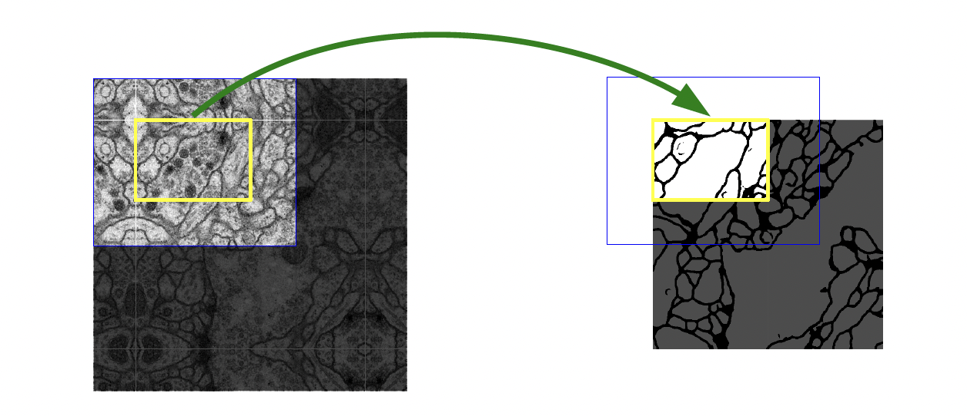
Architecture of U-Net
Overlap-tile Strategy
Overlap-tile strategy for seamless segmentation of arbitrary large images. Prediction of the segmentation in the yellow area, requires image data within the blue area as input. Missing input data is extrapolated by mirroring.
Because the edge part is no more continuous after cutting (which made the final concatenation difficult). The overlap-tile strategy is adopted.
https://arxiv.org/abs/1505.04597

Slide 14
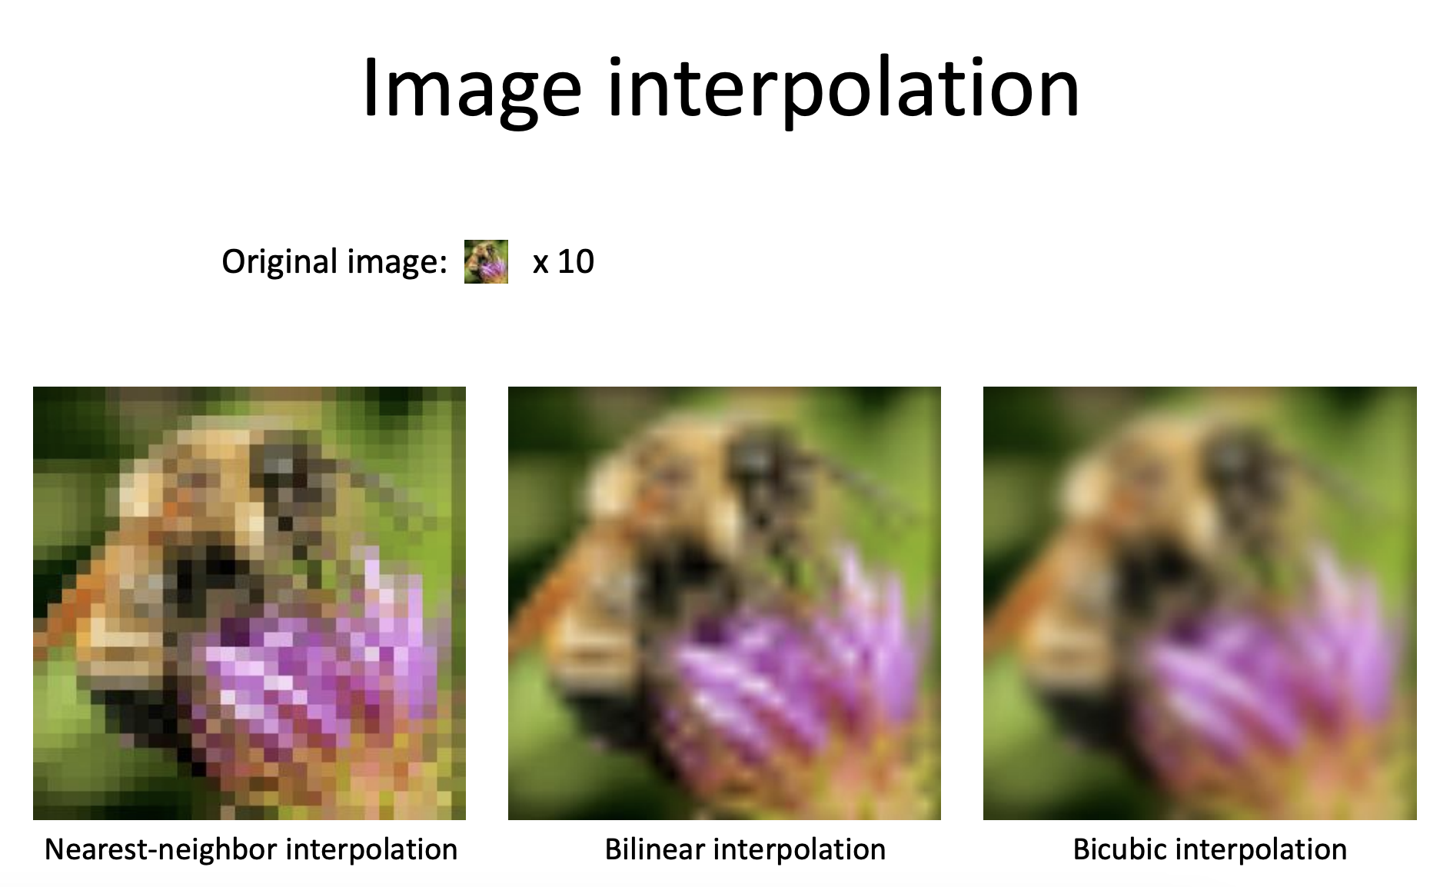
Upsampling (De-convolution)
Architecture of U-Net
https://www.cs.toronto.edu/~guerzhoy/320/lec/upsampling.pdf

Slide 15
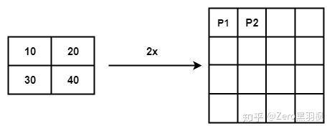
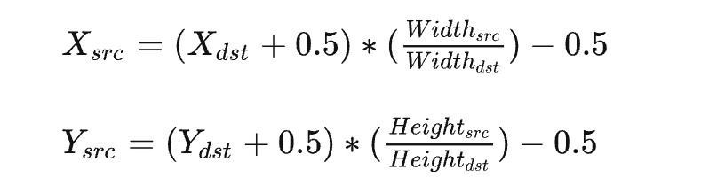
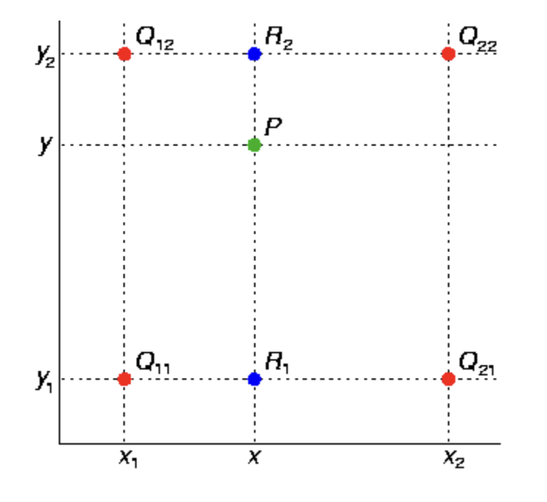
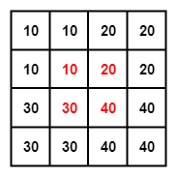
Architecture of U-Net
Upsampling (De-convolution)
Similar to the overlap-tile strategy
https://www.cs.toronto.edu/~guerzhoy/320/lec/upsampling.pdf

Slide 16
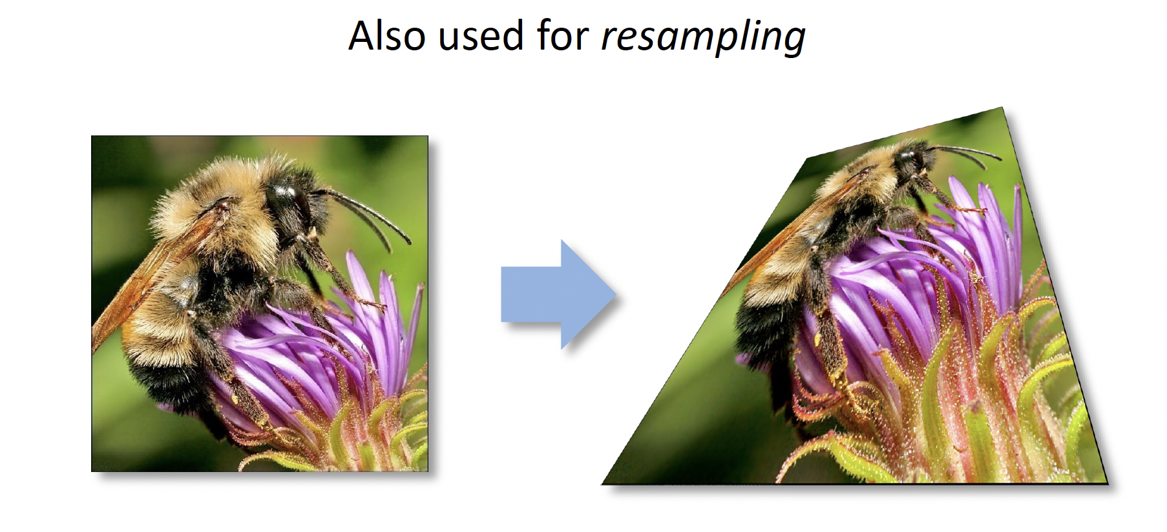
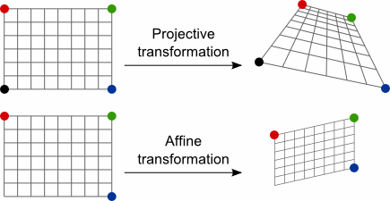
Architecture of U-Net
Image Interpolation
which we will use later
https://www.cs.toronto.edu/~guerzhoy/320/lec/upsampling.pdf

Slide 17
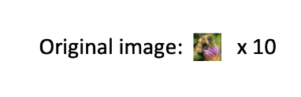
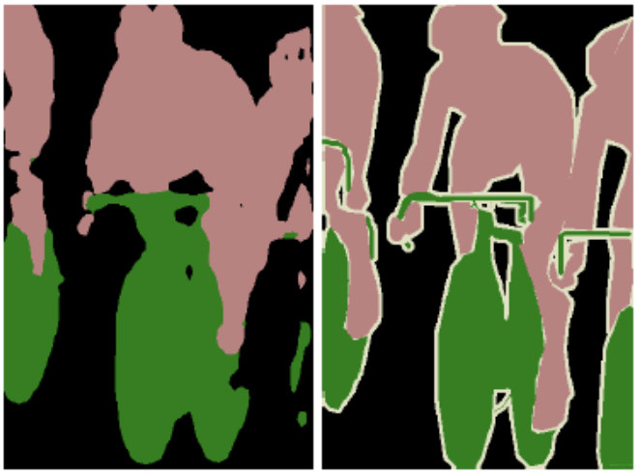
Architecture of U-Net
Skip-connection
In order to make up for the information lost in the down-sampling during the encoding stage, between the encoder and the decoder of the network, the U-Net uses the Concat layer to fuse the feature maps. Thus, more high-resolution information from the downsampling phase can be used during upsampling. So, the detailed information (semantic boundaries) in the original image can be recovered better. Thus, the segmentation performance (accuracy) will be improved.

Slide 18
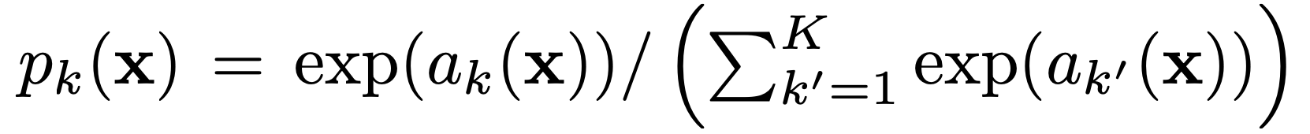
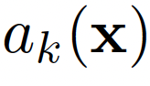
Architecture of U-Net
Loss Function
Pixel-wise Softmax Function
where represents the activation value of pixel x in the k-th channel of the feature map
k represents the k-th channel in the feature map
K represents the total number of classes

Slide 19
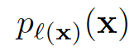
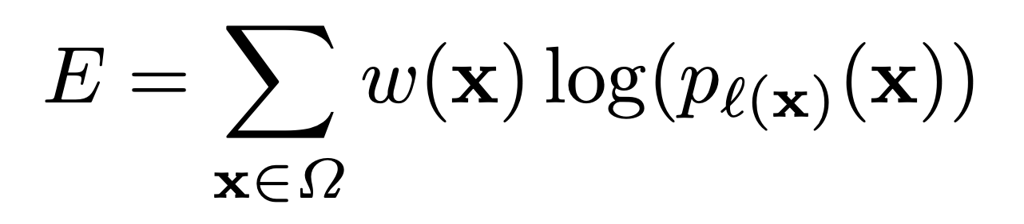
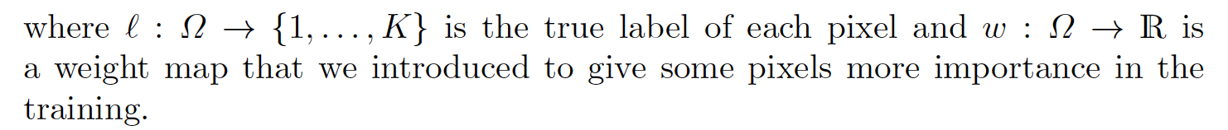
Architecture of U-Net
Loss Function
The cross entropy then penalizes at each position the deviation of
from 1 using

Slide 20
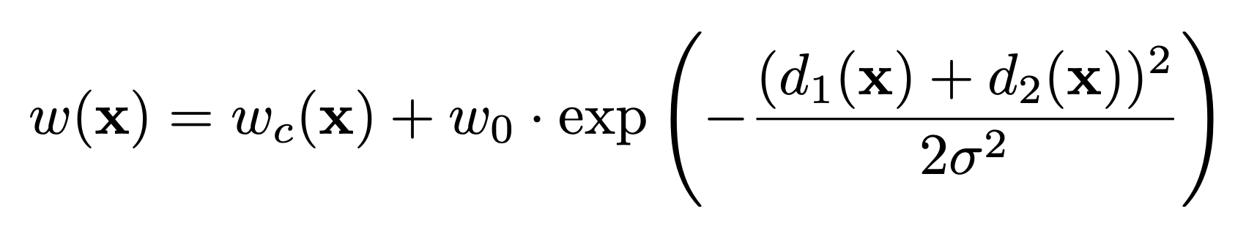
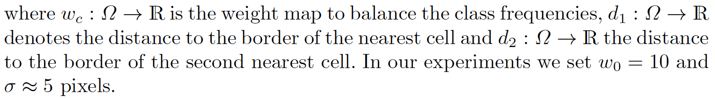
Architecture of U-Net
Loss Function
The weight map is given by
Details can be found at the paper: U-Net: Convolutional Networks for Biomedical Image Segmentation, https://arxiv.org/abs/1505.04597

Slide 21
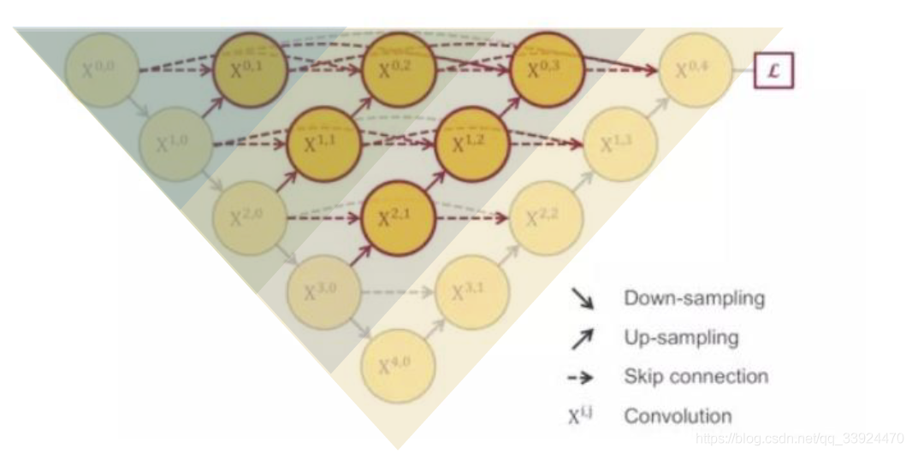
U-Net++: Improvement of U-Net
可能不需要这页

Slide 22
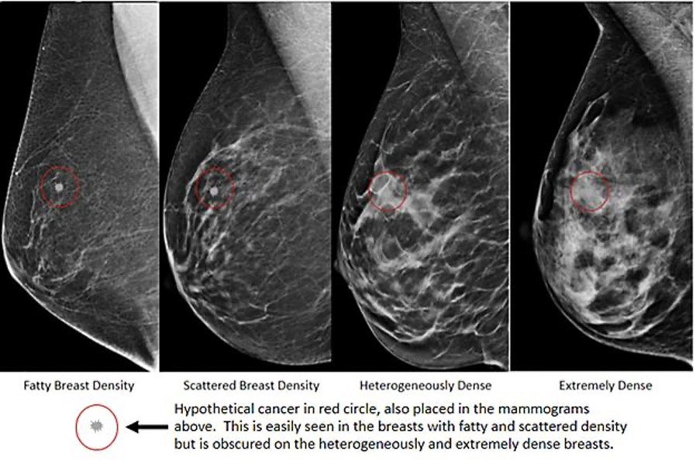
Our project
We only have classification data: a 0-1 problem

Slide 23
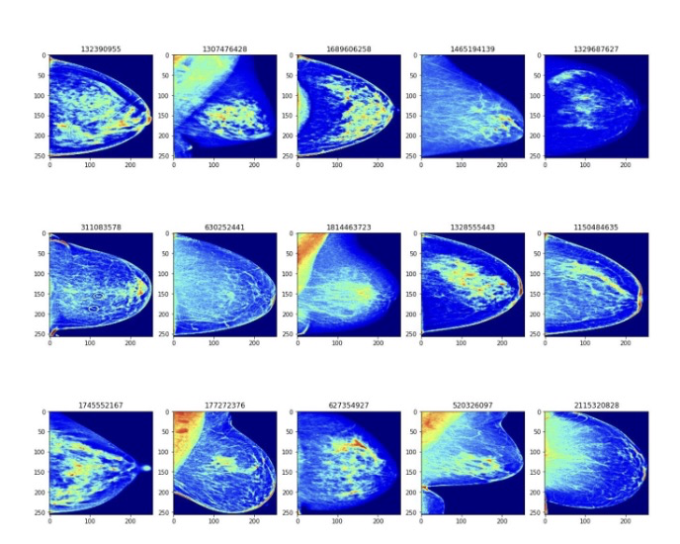
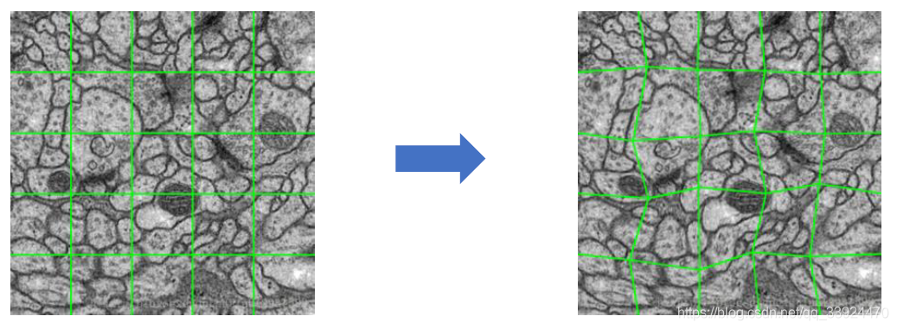
Augmentation
Data Preparation and Pre-processing
Distorting, Flipping, Cropping, Resizing, Brightness, Contrast, Dropout, etc.
https://www.kaggle.com/datasets/paulbacher/rsna-bcd-1024x512-preprocessed

Slide 24
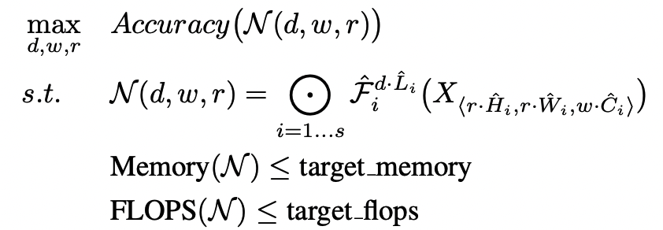
Efficient Net: Motivation
Depth?
Width?
Resolution?
The target of Efficient Net is to maximize the model accuracy for any given resource constraints, which can be formulated as an optimization problem.
N is the Conv Model
Different Network Width (w),
Depth (d)
Resolution (r) Coefficients
Xi : input tensor, with tensor shape Hi , Wi , Ci ,
Equations from: EfficientNet: Rethinking Model Scaling for Convolutional Neural Networks

Slide 25
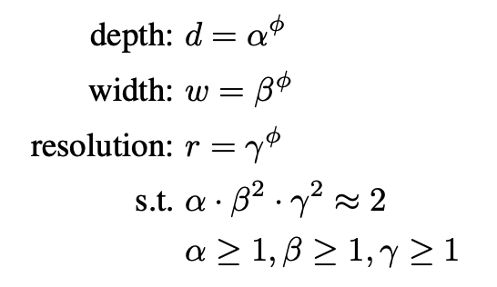
Efficient Net: main contribution
Compound Scaling Method:
Use a compound coefficient to uniformly scales network width, depth, and resolution
α, β, γ measures the ratio of depth, width and resolution respectively
β, γ is squared in the constraint because doubling the width or resolution will result in a four times of the computational effort, but doubling the depth will only result in a doubling of the computational effort.
Here, α, β, γ are constants that can be determined by a small grid search
Equations from: EfficientNet: Rethinking Model Scaling for Convolutional Neural Networks

Slide 26
Efficient Net: main contribution
Compound Scaling Method:
Use a compound coefficient to uniformly scales network width, depth, and resolution
The magnitude of φ corresponds to the magnitude of resources that consumed.
When φ is increased, it is equivalent to extending the three dimensions of the base model at the same time. The larger the model, the performance will be improved, and the resource consumption will also be increased
Equations from: EfficientNet: Rethinking Model Scaling for Convolutional Neural Networks

Slide 27
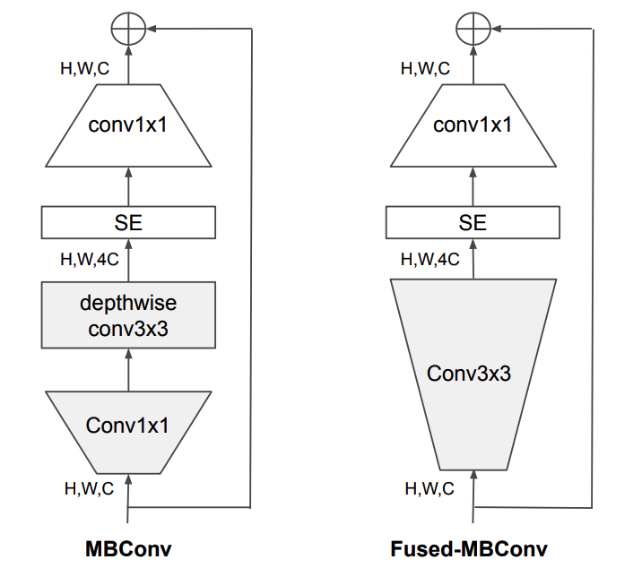
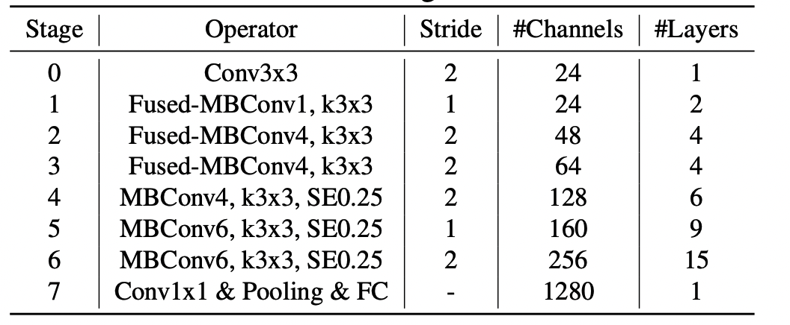
Efficient Net: adopted baseline model
Compare with original Efficient Net, Efficient Net V2 adopted new operators: Fused-MBConv
Better utilize mobile or server accelerators
Structure of MBConv and Fused-MBConv
Model Architecture and Image derived from the paper: EfficientNetV2: Smaller Models and Faster Training

Slide 28
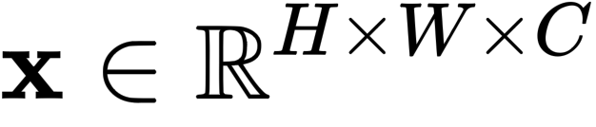
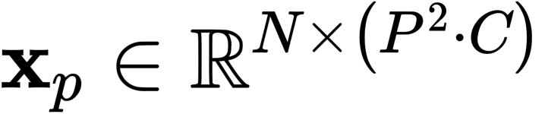
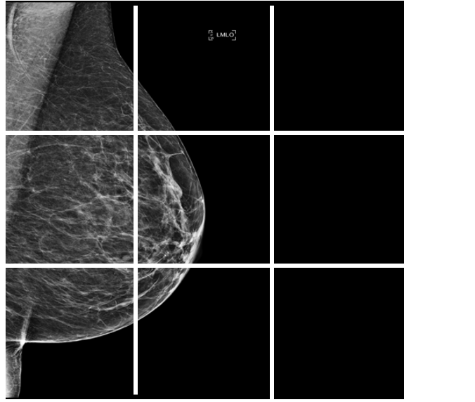
Vision Transformer: Procedure
1.Reshape the image
into a sequence of flattened 2D patches
(H, W): resolution of the original image
C: the number of channels
(P, P): is the resolution of each image patch
N = HW/(P^2): the resulting number of patches
Mammography Image derived from the dataset, image id:1442180348

Slide 29
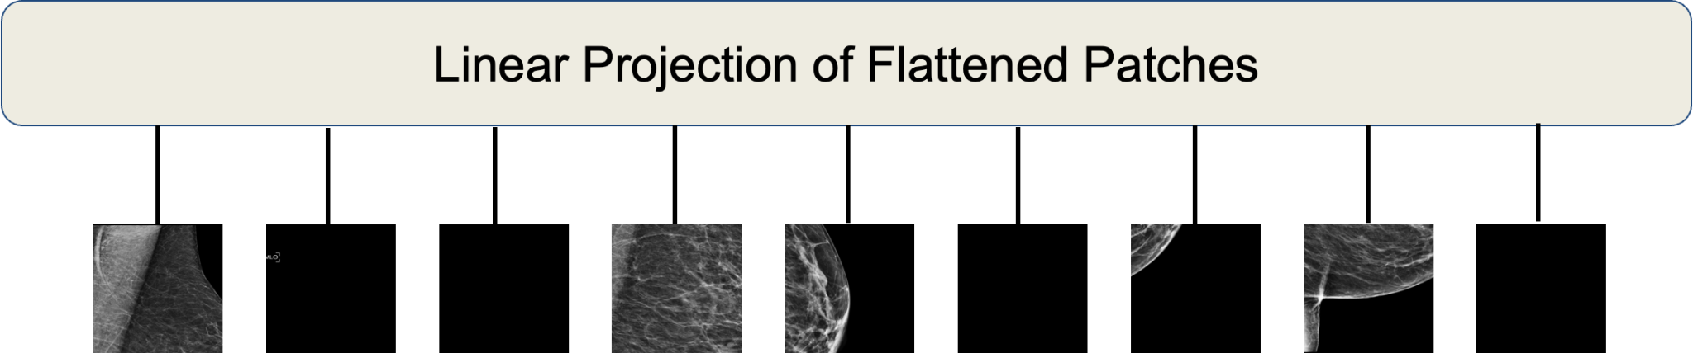
Vision Transformer: Procedure
2. Flatten the patches and map to D dimensions with a trainable linear projection E
Assuming that the input image is 224x224x3 and the original image shape of a patch is 16x16x3, then the image can be divided into (224/16)^2 =196 patches. Then, each patch is linearly mapped to a one-dimensional vector, and the length of this one-dimensional vector is 16∗16∗3=768. You put 196 tokens on top of each other and the final dimension is [196, 768]

Slide 30

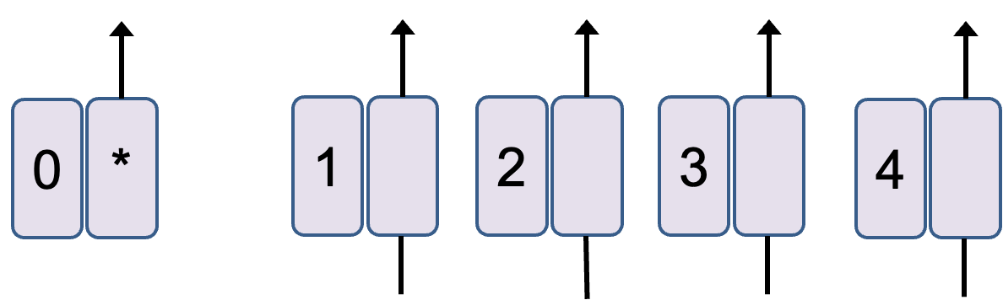
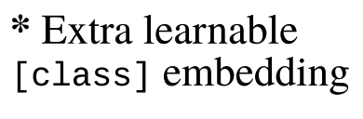
Vision Transformer: Procedure
3. The sequence of the embedded image patches was prefixed with a learnable class embedding .The values correspond to the classification outcome Y
Both during pre-training and fine-tuning, a classification head is attached to the embedding vectors. The classification head is implemented by a MLP with one hidden layer at pre-training time and by a single linear layer at fine-tuning time.
Class
MLP
Head

Slide 31
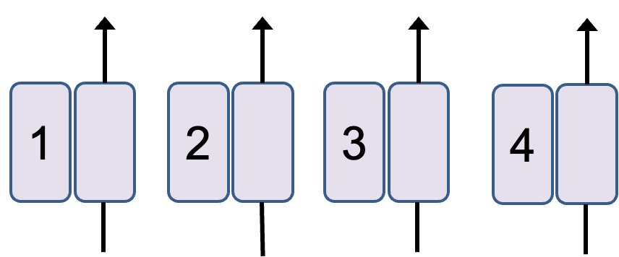
Vision Transformer: Procedure
4. Position embeddings are added to the patch embeddings to retain positional information.
Positional information: 1-dimensional positional embedding: Considering the inputs as a sequence of patches in the raster order
Raster Order:
Patch +
Position Encoding

Slide 32
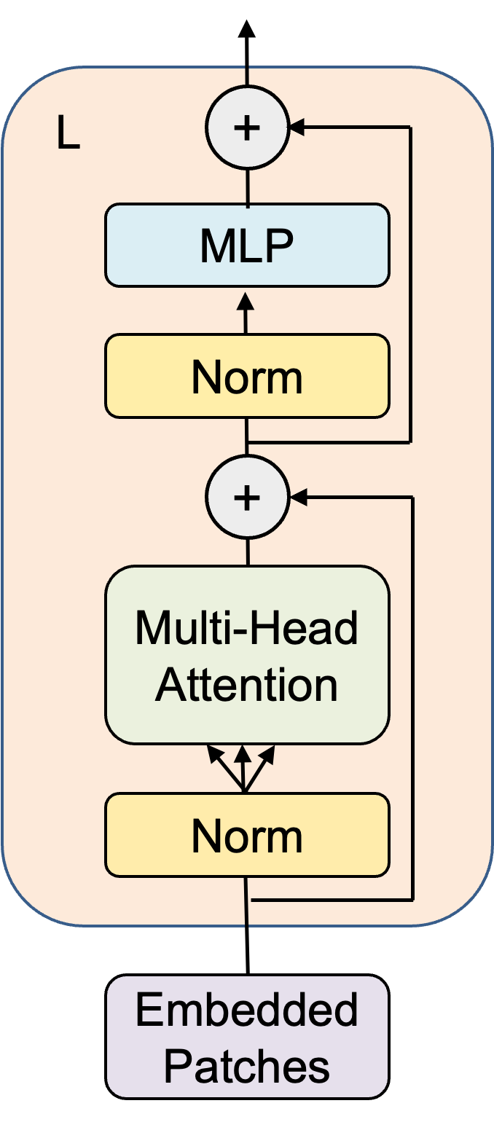
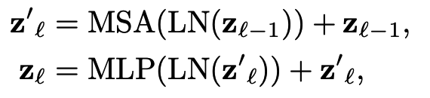
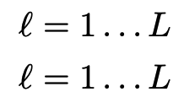
Vision Transformer: Procedure
The Transformer encoder consists of alternating layers of multiheaded self-attention (Lecture 7 Page 35-36) and MLP blocks (Equation shown below). Layernorm (LN) is applied before every block, and residual connections after every block.
We fed embedding patches to the transformer–encoder network, which is a stack of L identical layers, to conduct the classification(Prediction).

Slide 33
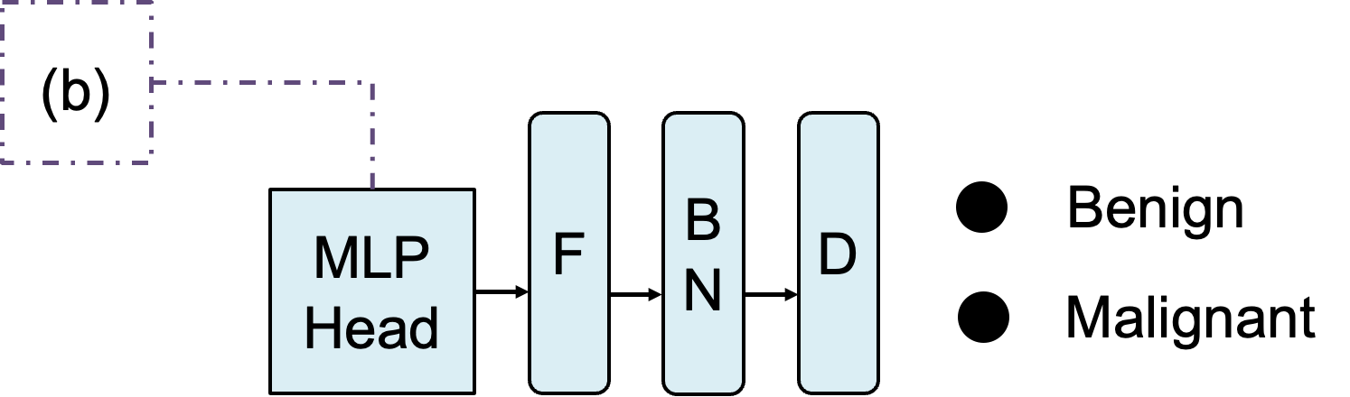
Vision Transformer: Procedure
Use Tanh
as activation function
Likelihood
F:flattening; BN:batch normalization; D:dense
The downstream task is the classification model, so the corresponding class token needs to be extracted to obtain the Prediction result.
Compare to the original model, in our task vision transformer model was used the way that the last layer was replaced with a flattening layer followed by batch normalization and an output dense layer.

Slide 34
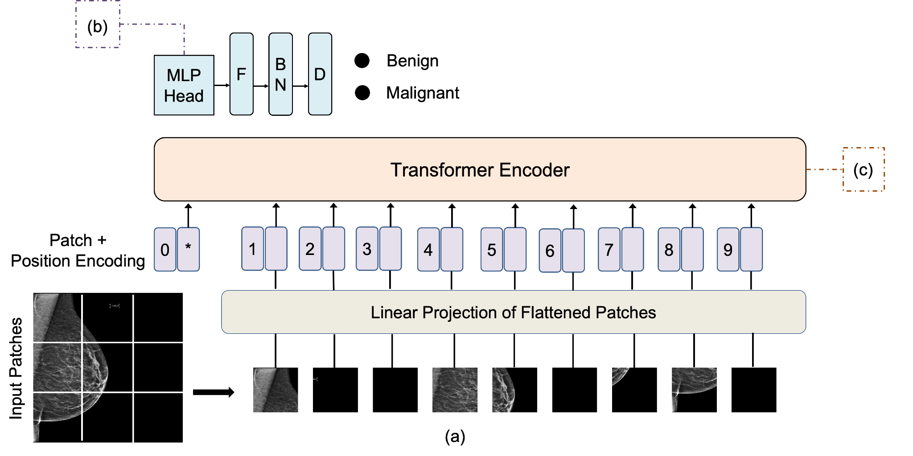
Architecture of ViT for Breast Cancer Detection

Slide 35
Experimental Setting
Model Backbone:
EfficientNetV2:
https://github.com/d-li14/efficientnetv2.pytorch
Tan, Mingxing, and Quoc Le. "Efficientnetv2: Smaller models and faster training." International conference on machine learning. PMLR, 2021.
Vit-base-patch16-224: https://huggingface.co/google/vit-base-patch16-224
Dosovitskiy, Alexey, et al. "An image is worth 16x16 words: Transformers for image recognition at scale." ICLR 2021

Slide 36
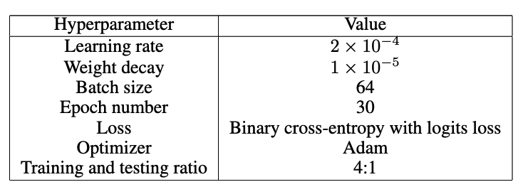
Experimental Setting
Training Hyperparameters
Binary cross entropy with logits loss is actually binary cross entropy loss, but the input doesn't have to be between 0 and 1, and the sigmoid function is automatically adds.

Slide 37
04
Performance
Evaluation

Slide 38
Performance Metrics
Probabilistic F1 Score
for More Thorough Evaluation of Classification Models
A data set S: (x_1,y_1 ),…,(x_n,y_n )∈R^p× {C_1,…,C_m }
x_i : a vector of p features corresponding to sample i
y_i : the class corresponding to sample i
{C_1,…,C_m }: the set of possible classes
A classification model M :R^p↦ {C_1,…,C_m }. trained to predict label assignment given an input vector xi . The model assigns a confidence score (or probability if the model is probabilistically calibrated) to each possible class C_j for any given input vector x_i , signifying the model’s confidence that Cj is the true class for the given input vector (which can also be expressed as C_j = yi).

Slide 39
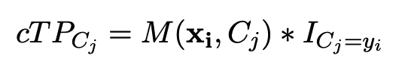



Performance Metrics
Probabilistic F1 Score
for More Thorough Evaluation of Classification Models
confidence score: M(x_i , C_j ). The class with the highest confidence score will be the model’s predicted class y^ .
The commonly used definition of true positive for class C_j is any model prediction for which y^_i = y_i = C_j .
Confidence true positive:
Confidence false positive:
Yacouby, Reda, and Dustin Axman. "Probabilistic extension of precision, recall, and f1 score for more thorough evaluation of classification models." Proceedings of the first workshop on evaluation and comparison of NLP systems. 2020.

Slide 40

Results
Five-fold cross-validation was used to compare the model performances.
The vision-transformer-based transfer-learning model exhibited superior performance on the provided dataset

Slide 41
05
Discussion &
Future Work

Slide 42
Discussion
The vision-transformer-based transfer-learning approach provided the highest quantitative and statistical measures for predicting the likelihood of breast mammograms as being from benign or malignant tissues. This proves the effectiveness and quality of the vision-transformer-based transfer-learning approach for detecting breast cancer from mammograms.
Possible Reason
The ability to capture global information from the early layers and the deep self-attention mechanism that enables features in each patch to be carefully analyzed for decision making

Slide 43

Discussion
Other Findings
Vision transformer models are more effective and efficient( computationally less expensive) when used for transfer learning on the provided dataset than training the models from scratch
Future Work/Limitations of this project
For each patient, there is four mammography images, so the features may have some inner correlations
Left-Right Differences are important for diagnosis of breast cancer
Image Credit: https://www.kaggle.com/competitions/rsna-breast-cancer-detection/discussion/390974

Slide 44

Discussion
Future Work/Limitations of this project
Multi-View/ Pyramid Fusion Model
Motivated by the paper: An Unsupervised-Learning-Based Approach for Automated Defect Inspection on Textured Surfaces
Reduce/crop the image to different scales
to catch both the global features and the local features.
Image Credit: An Unsupervised-Learning-Based Approach for Automated Defect Inspection on Textured Surfaces

Slide 45


This leaderboard is calculated with approximately 28% of the test data.
The private leaderboard is calculated with approximately 72% of the test data.

Slide 46

Data Preparation and Pre-processing
Original image arrays were converted into 2048 x 2048 x 1
Images were then cropped to exclude blank space
YOLO model was trained to generate breast bbox
Compared to simple rule-based breast extraction, YOLO cropped images usually have a smaller region, which seemed to prevent our models from overfitting
In order to shorten inference time, we used simple rule-based crop during inference
Affine transform, V/H flip, brightness/contrast, blur, CLAHE, distortion, dropout
https://www.kaggle.com/datasets/radek1/rsna-mammography-images-as-pngs

Slide 47

Award-winning architecture
https://www.kaggle.com/competitions/rsna-breast-cancer-detection/discussion/390974

Slide 48

https://www.kaggle.com/competitions/rsna-breast-cancer-detection/discussion/390974

Slide 49
Discussion
What have we learned?
Grabbing the ideas of some classical medical image analysis model
Learn how to implement the efficient net, vision transformer-based method in Pytorch framework
Study how to use Fast AI, Hugging Face library to help set up the experiment framework
Medical image processing technology: such as how to convert dcm image into png image
How to make efficient group collaboration

Slide 50
References
Łukasiewicz S, Czeczelewski M, Forma A, Baj J, Sitarz R, Stanisławek A. Breast Cancer-Epidemiology, Risk Factors, Classification, Prognostic Markers, and Current Treatment Strategies-An Updated Review. Cancers (Basel). 2021 Aug 25;13(17):4287. doi: 10.3390/cancers13174287. PMID: 34503097; PMCID: PMC8428369.
Milosevic, Marina et al. ‘Early Diagnosis and Detection of Breast Cancer’. 1 Jan. 2018 : 729 – 759.
Anderson, B.O., Braun, S., Lim, S., Smith, R.A., Taplin, S. and Thomas, D.B. (2003), Early Detection of Breast Cancer in Countries with Limited Resources. The Breast Journal, 9: S51-S59. https://doi.org/10.1046/j.1524-4741.9.s2.4.x
Yacouby, Reda, and Dustin Axman. "Probabilistic extension of precision, recall, and f1 score for more thorough evaluation of classification models." Proceedings of the first workshop on evaluation and comparison of NLP systems. 2020.
Tan, Mingxing, and Quoc Le. "Efficientnet: Rethinking model scaling for convolutional neural networks." International conference on machine learning. PMLR, 2019.
Tan, Mingxing, and Quoc Le. "Efficientnetv2: Smaller models and faster training." International conference on machine learning. PMLR, 2021.
Dosovitskiy, Alexey, et al. "An image is worth 16x16 words: Transformers for image recognition at scale." arXiv preprint arXiv:2010.11929 (2020).
Mei, Shuang, Hua Yang, and Zhouping Yin. "An unsupervised-learning-based approach for automated defect inspection on textured surfaces." IEEE Transactions on Instrumentation and Measurement 67.6 (2018): 1266-1277.

Slide 51



Thanks!
Do you have any questions?

